Slide 1

Introduction to Computer Event Groups
Professor : Jake Tarn
Lecturer: Sunny

Slide 2
Event Groups
xEventGroupCreate()
EventGroupHandle_t xEventGroupCreate( void );
xEventGroupSetBits()
EventBits_t xEventGroupSetBits(
EventGroupHandle_t xEventGroup,
const EventBits_t uxBitsToSet
);

Slide 3
Event Groups
xEventGroupWaitBits()
EventBits_t xEventGroupWaitBits(
const EventGroupHandle_t xEventGroup,
const EventBits_t uxBitsToWaitFor,
const BaseType_t xClearOnExit,
const BaseType_t xWaitForAllBits,
TickType_t xTicksToWait
);

Slide 4
synchronization

Slide 5
Event Group API
xEventGroupSync()
EventBits_t xEventGroupSync(
EventGroupHandle_t xEventGroup,
const EventBits_t uxBitsToSet,
const EventBits_t uxBitsToWaitFor,
TickType_t xTicksToWait
);

Slide 6
Event Groups

Slide 7
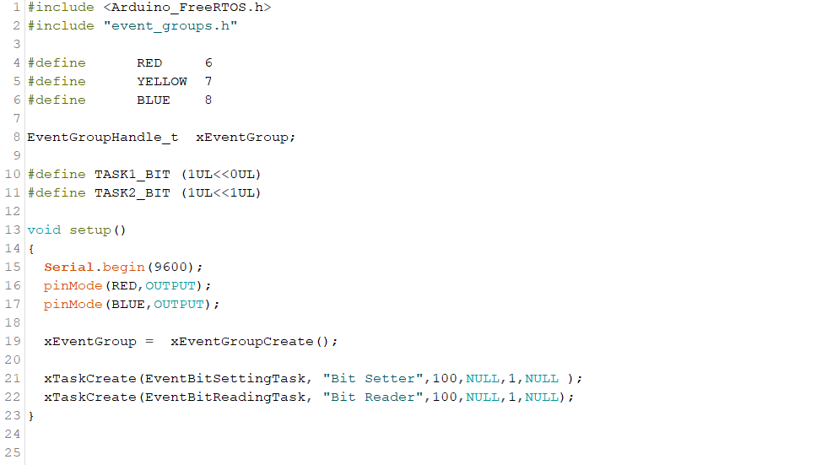

Slide 8
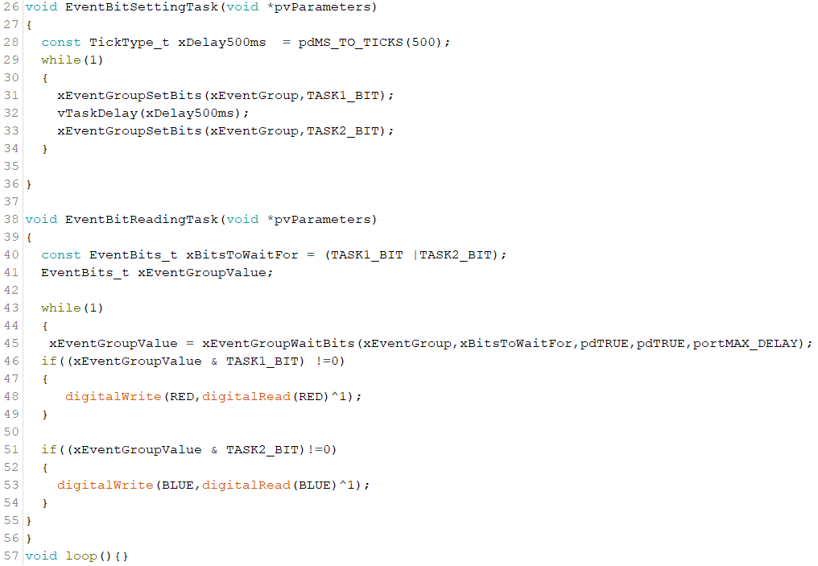

Slide 9
Event Groups 2

Slide 10
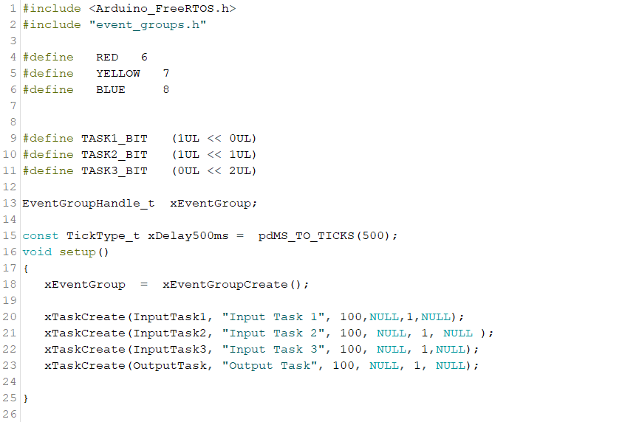

Slide 11
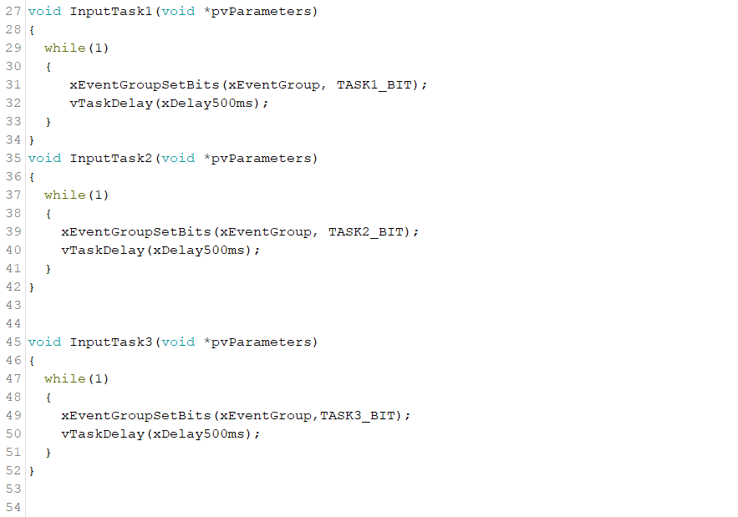

Slide 12
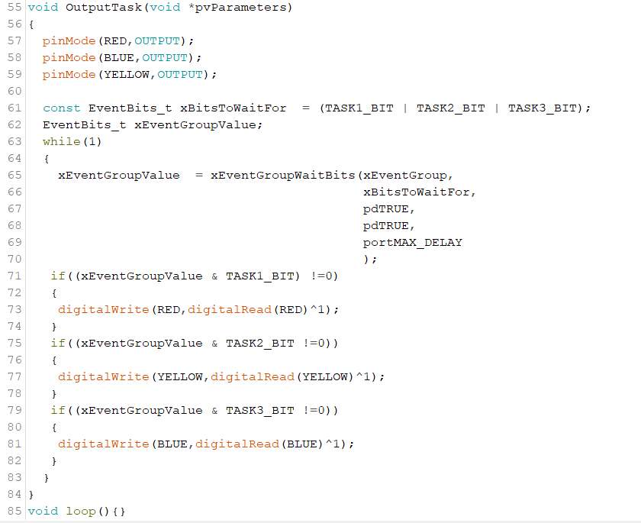

Slide 13
Syncing tasks with event groups

Slide 14
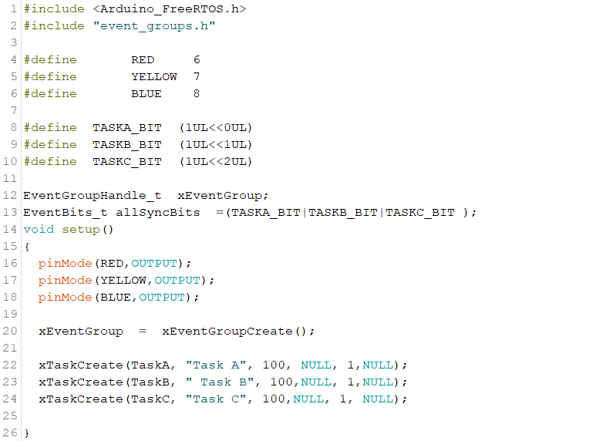

Slide 15
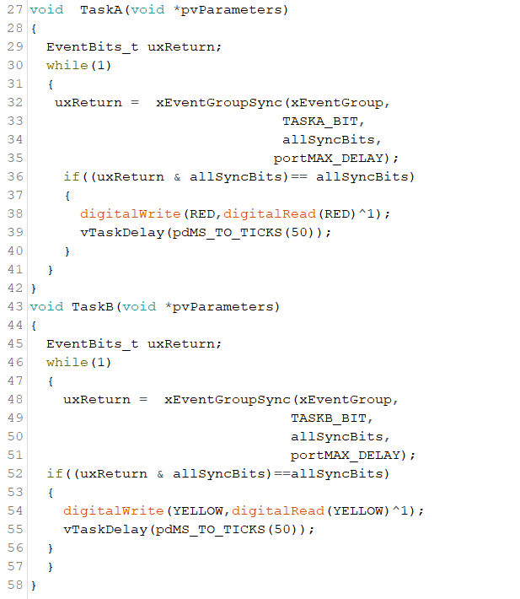

Slide 16
